Slide 1
COE 381
16-bit Microprocessor Simulation Presentation
Class: BSc. Computer Engineering 3
Group Name: Tensor
Date: May, 2022

Slide 2
TENSOR GROUP MEMBERS
8252919
8259719
8264819
8266119
8263419
8253719
Alhassan Machele Ahmed
Idrisu Issaka Gibril
Osei Kwaku Nana Kevin
Tetteh Kwame Jesse
Nana Kwame Ofori-Boakye
Angmortey Benjamin Kubi

Slide 3
TABLE OF CONTENTS
01
02
INTRODUCTION
ISA
03
04
COMPONENTS
LIMITATIONS
Specifications
Overview
Instructions & Opcodes
Instruction Formats
Program Counter,
Register File, ALU,
Control Unit
Bottlenecks and
Constraints

Slide 4
01
OVERVIEW

Slide 5
SPECIFICATIONS
ADDRESS BIT WIDTH | 16 BITS
DATA BUS WIDTH | 16 BITS
INSTRUCTION LENGTH | 16 BITS
REGISTER COUNT | 16
INSTRUCTION COUNT | 14
TENSOR
16-BIT

Slide 6
OVERVIEW
16-bit microprocessor
Based on RISC architecture inspired by MIPS I
Harvard Architecture – separate instruction and data memory
Memory is word-addressable (16 bits per location)
Total Memory addressable = 2¹⁶ x 2 bytes = 128 KB.

Slide 7
02
ISA
Instruction Set Architecture

Slide 8
ISA - Overview
The microprocessor can operate on 14 basic instructions.
Each instruction falls under one of three categories
Category | Instructions
Arithmetic/Logic | ADD, ADDI, INCR, SUB, SUBI, DECR, AND, OR, XOR, NOT
Data Transfer | LOAD, STORE, MOV
Branch | JUMP

Slide 9
ISA – Instruction Format
For simplicity, all instructions have a maximum length of 16 bits
Each of the 14 instructions follows one of four instruction formats
The instruction formats are as follows:
R-format
I-format
M-format
J-format

Slide 10
ISA – R-Format Instructions
For instructions that utilize 3 registers.
Rd – destination register
Rs & Rt – source registers
Instructions: ADD, SUB, AND, OR, XOR, NOT, MOV
Some instructions won't use all three registers. Eg. NOT
​OPCODE | ​Rd | Rs | Rt
​4 bits | 4 bits | 4 bits | 4 bits

Slide 11
ISA – I-Format Instructions
For instructions that utilize 2 registers and an immediate value from the instruction.
Rd – destination register
Rs – source registers
Immediate – 4-bit immediate value
Instructions: ADDI, SUBI, INCR, DECR
​OPCODE | ​Rd | Rs | Immediate
​4 bits | 4 bits | 4 bits | 4 bits

Slide 12
ISA – M-Format Instructions
For that utilize one register and an immediate value .
Rd – destination/source register
Immediate – 8-bit immediate value for memory addressing
Instructions: LOAD, STORE
For the STORE instruction, Rd is used as a source register.
​OPCODE | ​Rd | Immediate
​4 bits | 4 bits | 8 bits

Slide 13
ISA – J-Format Instructions
For the JUMP instruction that utilizes only an immediate value .
Immediate – 12-bit immediate value for memory addressing
Instructions: JUMP
​OPCODE | Immediate
​4 bits | 8 bits

Slide 14
03
COMPONENTS

Slide 15
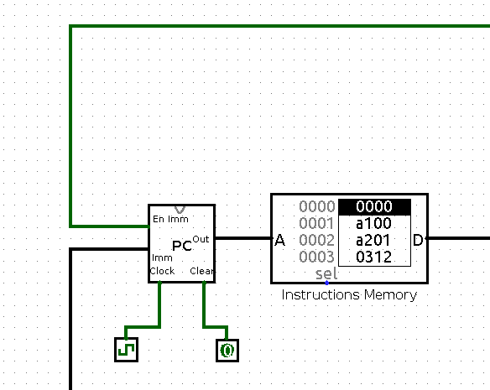
Program Counter
The program counter loads the address of the next instruction to be executed when it is triggered by the clock.
It can also be made to branch / jump to a specified address in the instruction memory

Slide 16
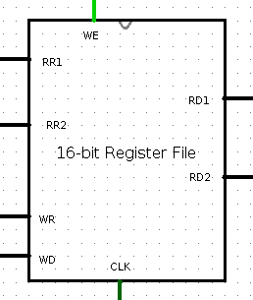
Register File
The register file is simply a housing for all 16 general-purpose registers used by the microprocessor.
Statistics:
2 read-data ports, 2 read-address ports
1 Write-data port, 1 Write-address port
1 Write-enable, 1 clock

Slide 17
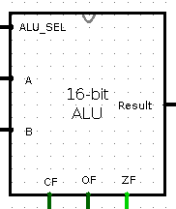
Arithmetic Logic Unit (ALU)
The ALU contains sub-circuits which are responsible for performing all arithmetic and logic operations defined in the ISA.
It uses the `ALU_SEL` control signal to determine which sub-circuit is required to perform a certain operation.
It also has carry, overflow, and zero flags.

Slide 18
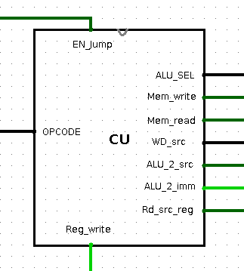
Control Unit
The control unit is the operations manager.
It emits specific control signals for each operation, that direct the other components to successfully execute the instruction.

Slide 19
04
LIMITATIONS
What constraints does this design come with?

Slide 20
LIMITATIONS
The I-format instructions reserve only 4 bits for the immediate, hence they can access a small range of numbers (0 to 2⁴-1 for unsigned and –2³ to 2³-1 for signed)
The JUMP instruction can only go as far as memory address 2¹² whereas the farthest addressable memory location is 2¹⁶ - 1.

Slide 21
LIMITATIONS
The LOAD and STORE instructions can only access as far as memory address 2⁸-1 because their instruction format (M-format) permits only an 8-bit immediate for specifying memory addresses.

Slide 22
THANKS!

